Slide 1
Independent Validation
Qualitative Aspects
Workshop Session 1

Slide 2
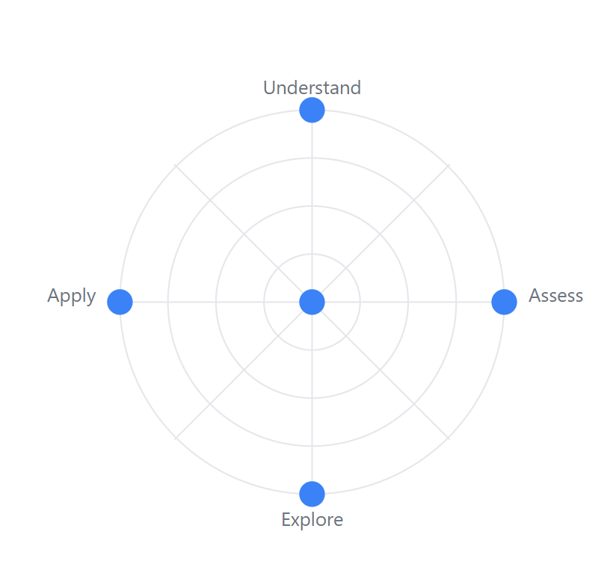
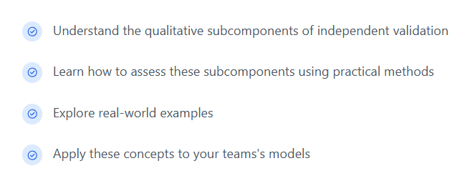
Workshop Objectives

Slide 3
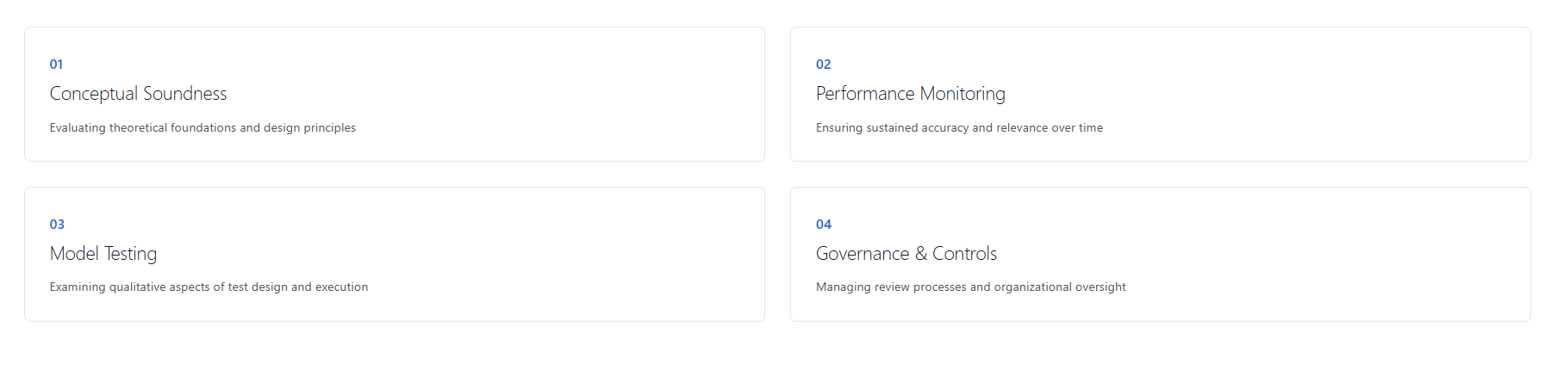
Workshop Structure

Slide 4
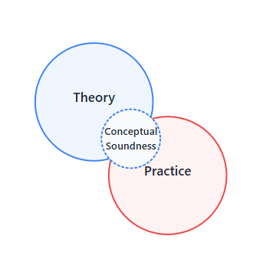
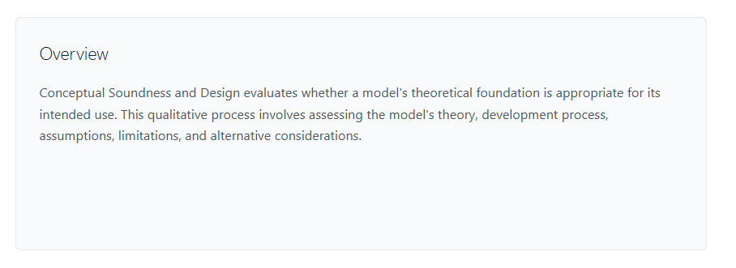
Conceptual Soundness and Design

Slide 5
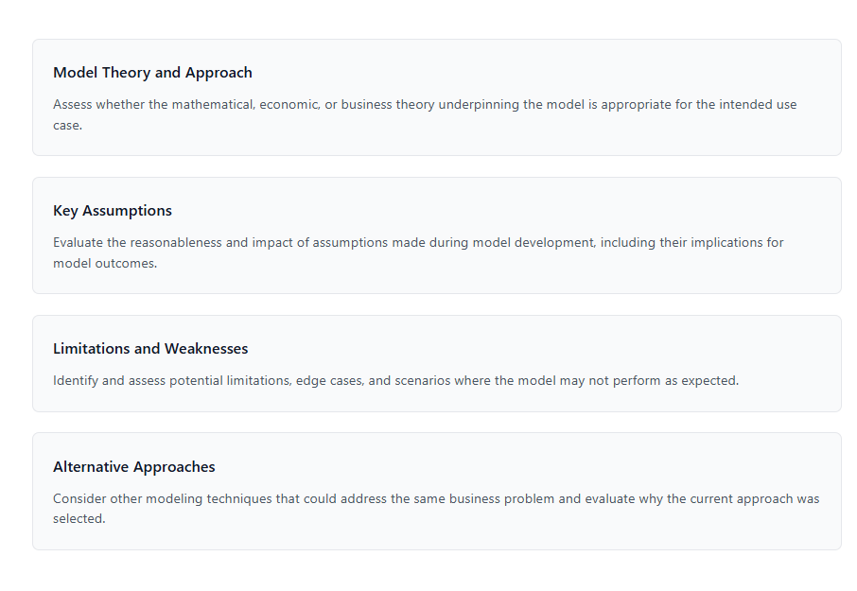
Conceptual Soundness and Design

Slide 6
Model Theory and Approach
A
B

Slide 7
Model Theory and Approach
B
A
Linear Regression to predict claim amounts
“Historical Claims data shows a steady linear trend”

Slide 8
Model Theory and Approach
B
A
Linear Regression to predict claim amounts
“Historical Claims data shows a steady linear trend”

Slide 9
Model Theory and Approach
B
A
Linear Regression to predict claim amounts
“Historical Claims data shows a steady linear trend”

Slide 10
Model Theory and Approach
B
A
Linear Regression to predict claim amounts
“Historical Claims data shows a steady linear trend”
The theory matches the problem—linear regression suits their data’s pattern—and they justify it with evidence.
✅

Slide 11
Model Theory and Approach
A
B

Slide 12
Model Theory and Approach
A
B
They use a random forest for churn prediction
They do not give an explanation
Churn prediction is the process of estimating which customers are likely to stop using a product or service

Slide 13
Model Theory and Approach
A
B
They use a random forest for churn prediction
They do not give an explanation
Without explaining why random forest fits churn prediction (capturing non-linear patterns), validators can’t assess its appropriateness
✏️
Churn prediction is the process of estimating which customers are likely to stop using a product or service

Slide 14
Key Assumptions
Data trends and historical patterns
Example: Assume a 0.05 significance level for regression coefficients, with sensitivity analysis to confirm robustness.
Model Parameters
Example: Assume inflation impacts repair costs, supported by economic forecasts from credible sources.
External Factors and Market Conditions
Example: Assume customer age is a key churn driver, corroborated by feature importance in a random forest model.
Customer Behavior and Demographics
Example: Assume customer age is a key churn driver, corroborated by feature importance in a random forest model.
Vendor or Third-Party Selection
Example: Assume a vendor’s actuarial software is reliable, based on their track record and contract terms.

Slide 15
Limitations and Weaknesses
Rare or Extreme Events
Example: Linear regression may struggle with high-cost claims (e.g., totaled luxury vehicles); recommend quarterly outlier monitoring.
Data Volume and Quality
Example: Random forest may overfit with a small dataset (e.g., 1,000 customers); suggest periodic retraining with larger samples.
Data Relevance and Timeliness
Example: Model performance may degrade if claims data excludes recent electric vehicle trends.
Model Complexity and Fit
Example: Linear regression may miss non-linear claim spikes; consider complementary models for validation.
Vendor or System Dependencies
Example: Reliance on a vendor’s outdated algorithm could skew predictions; monitor vendor updates regularly.

Slide 16
Alternative Approaches
Could a less complex model suffice?
Could a more sophisticated method improve performance?
Are there other techniques better suited to your data?
Statistical -> Machine Learning
Machine Learning -> Statistical

Slide 17
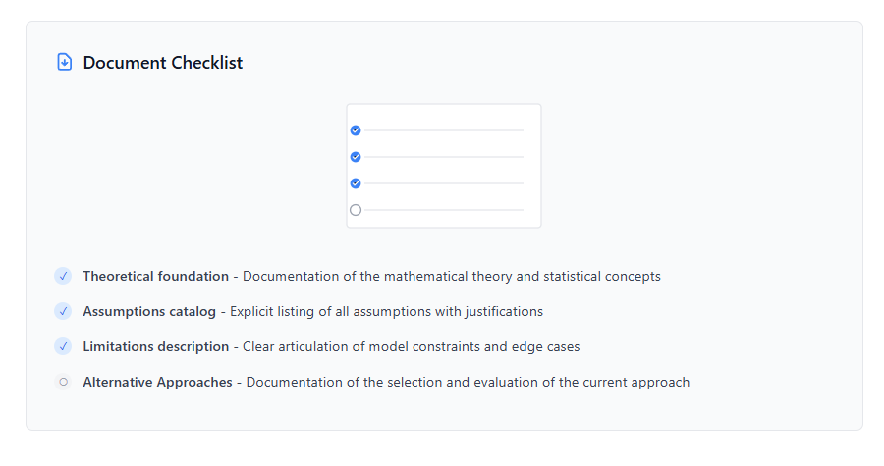
Conceptual Soundness and Design

Slide 18
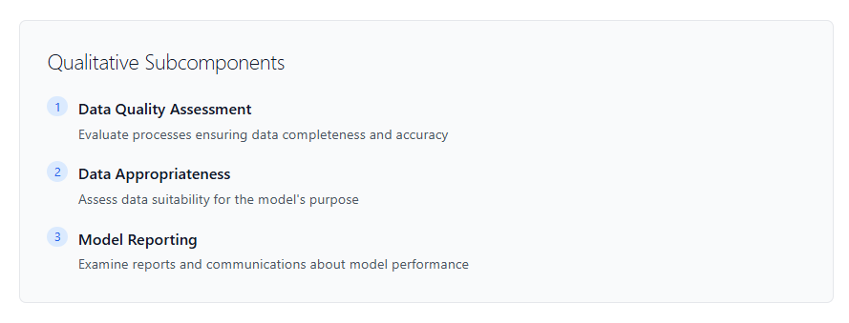
Ongoing Performance Monitoring

Slide 19
Data Quality
Data Appropriateness
Focuses on the integrity of the data itself—ensuring it is complete (no missing values) and accurate (no errors)
Evaluates whether the data fits the model’s specific purpose and current context

Slide 20
Data Quality
Are data quality processes and updates clearly defined?
How does the team handle Null Values?
Were transformations done to data?

Slide 21
Data Appropriateness
Is there evidence of data relevance checks and regular reviews?
Does the team use outdated data?
Documentation of vendor selection
Evaluates whether the data fits the model’s specific purpose and current context

Slide 22
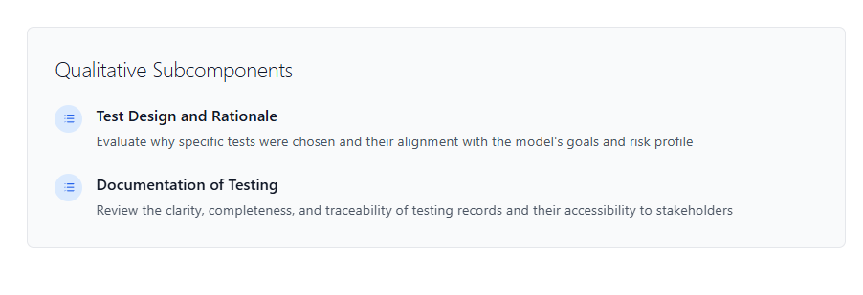
Model Testing

Slide 23
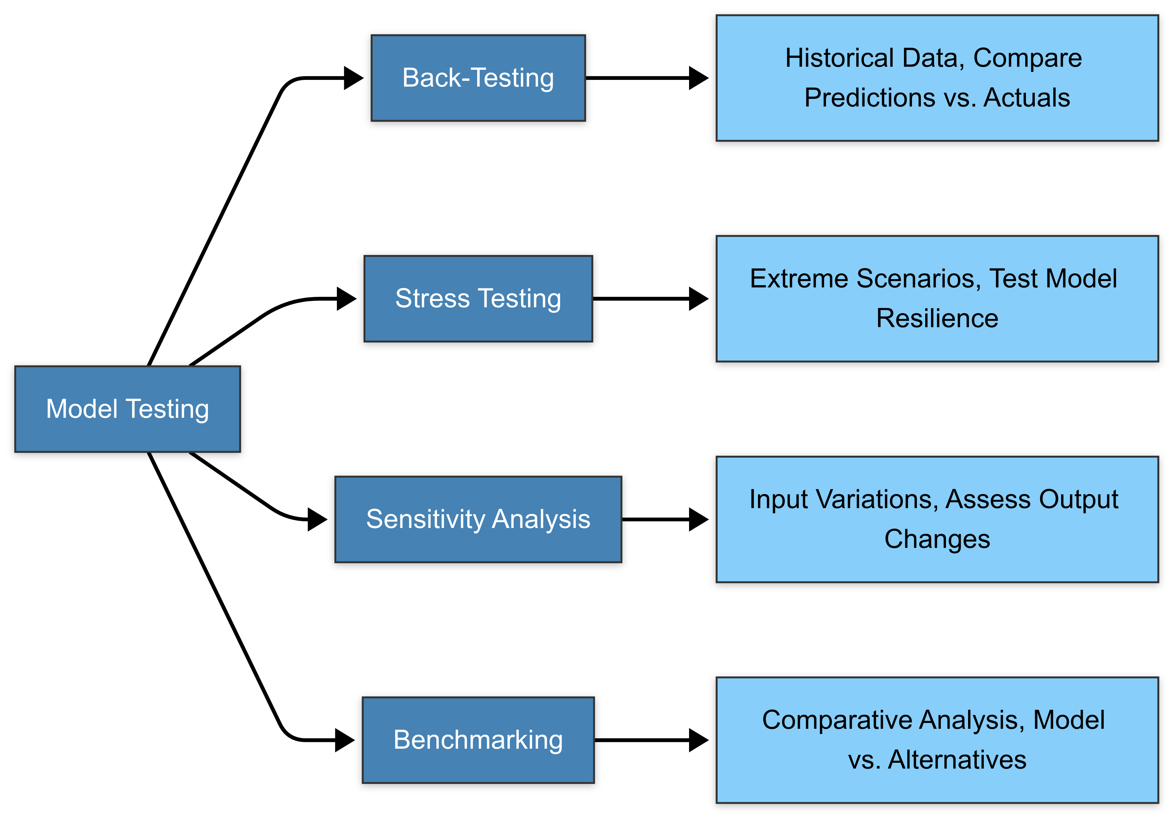

Slide 24
Test Design and Rationale: Why this test? Does it align it with your goal?
Example: Back-test a regression model with 2023 claims to ensure pricing aligns with real costs.

Slide 25
Test Design and Rationale: Why this test? Match it to your risk profile.
Example: Stress-test a random forest with a 20% premium hike to evaluate churn resilience.

Slide 26
Test Design and Rationale: Why this test? Target key assumptions.
Example: Vary regression input (e.g., repair cost inflation) by ±2% to test pricing stability.

Slide 27
Test Design and Rationale: Why this test? Ensure competitiveness.
Example: Benchmark a random forest churn model against a logistic regression baseline.

Slide 28
Documentation of Testing
Can an outsider understand the documentation?
Does the documentation rely solely on visuals, or does it balance visuals with written explanations
Are all critical details included, such as test methodology, data sources, assumptions, results, and stakeholder feedback

Slide 29
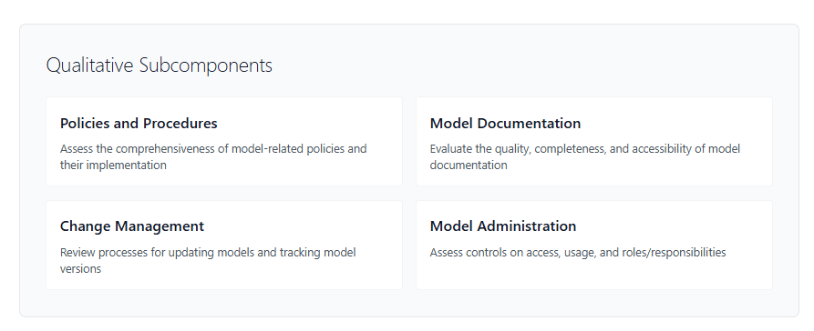
Governance and Controls

Slide 30
Do you have a Change Management Procedure?

Slide 31
What is that?

Slide 32
A process for updating the model and tracking your versions

Slide 33
Oh yeah

Slide 34
Formalizing Non-Written Protocols

Slide 35
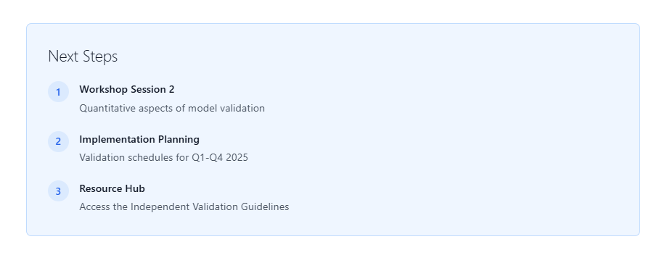
Thank You

